Slide 1
Online Store Application
System Development Project
By Liam Corcoran, Lucas Magnien, Nirosh Ratnam, and Yu-Tang Yu

Slide 2
Discussion
For our project, we intend to design and build an online store application cloud SAAS providing online POS for customers of client businesses, including collation of shopping information for business statistical analysis, and the creation of financial statements based on collated information. As described below, the focus of the project will be to provide exposure and feedback for business startups with new business identities and products as quickly and easily as possible, within a community setting.

Slide 3
Discussion – Binary Bazaar
Binary Bazaar is an online marketplace for "grassroots" startups who want to showcase their business identities and products to likeminded, community-oriented individuals. The focus of the project is on ease-of-use, and the rapid development of new ideas and products.

Slide 4
Risk Assessment
Personnel
Group members may leave the group or fall into a condition where they are not able to reach deadlines
Technology
Tools or strategies may fail due to unforeseen circumstances
Scope
The amount of work required for deadline may be beyond our abilities to accomplish in this term

Slide 5
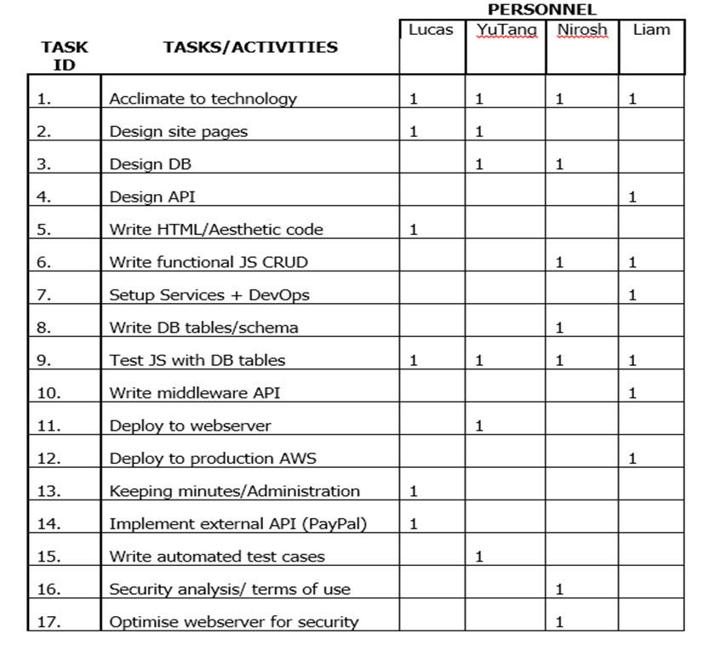
Task Breakdown – Project Responsibilites
At the beginning of this project our team has split tasks amongst individual comfort, knowledge, and skill.
Each individual group member will be developing through the next couple of weeks.

Slide 6
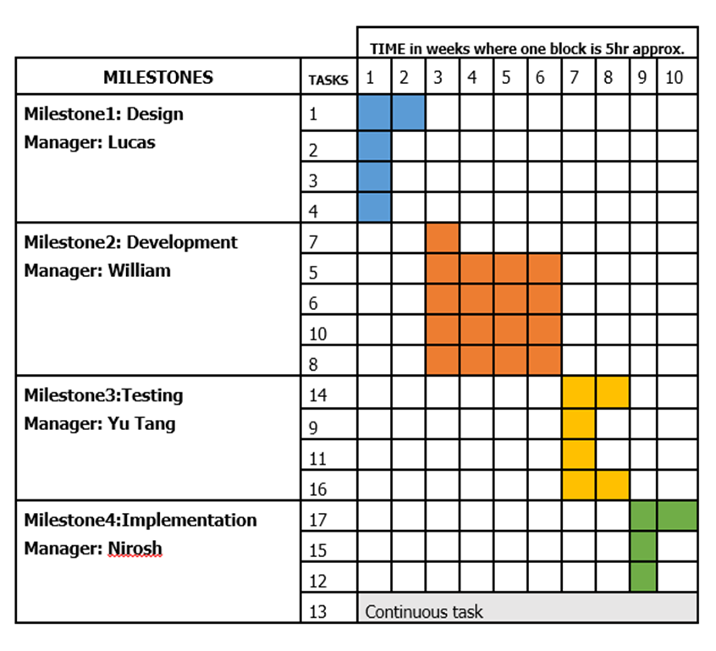
Task Breakdown – Milestone Chart
The group has created a schedule that shows weekly tasks that needs to be done by a weekly basis using a Milestone Chart

Slide 7
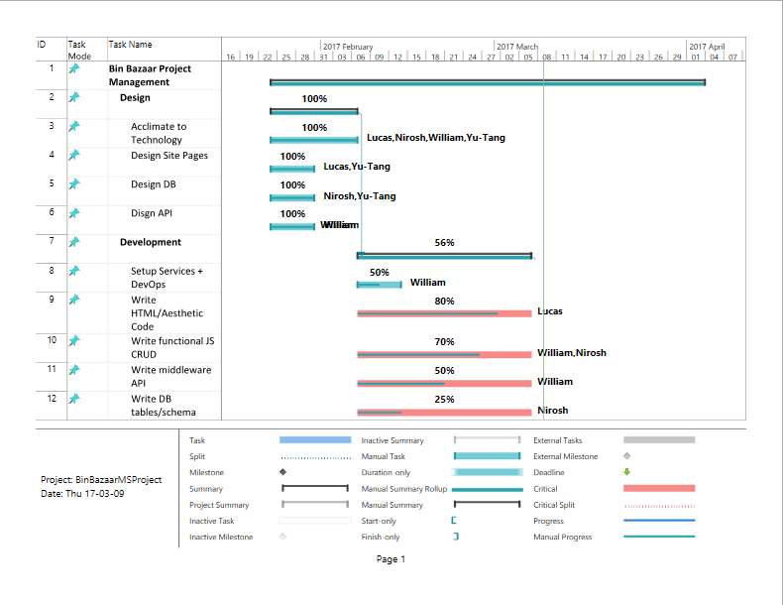
Task Breakdown – Gantt Chart

Slide 8
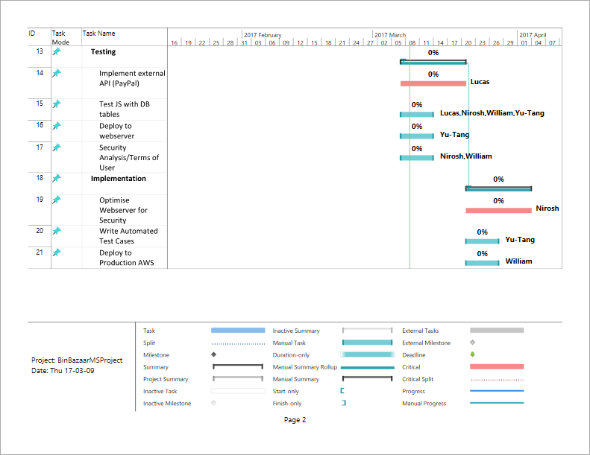
Task Breakdown – Gantt Chart

Slide 9
Task Breakdown
Site design
Index
Signup
Login
Store customization
Add/remove item
Store analytics
Cart
Checkout
Browse
Search results
Store page
Item page
Database design
User
Store
Item
review
Cart
Item

Slide 10
Task Breakdown
Technologies
UI framework: bootstrap (css/js) + Jquery
Create pages based on wireframes
JSON + XML
Write conversion in API and import export in site JS
Mongo DB
Write tables + relations, initialize server
Kong API
Write API listener, connect to webserver and DB
Restful integration with PayPal
Nginx webserver on AWS
Initialize and configure, then deploy site package (.war file), then deploy container (docker) to Amazon Web Server
Selenium test scripts running on Jenkins for each js function
Write test scripts and configure jenkins tasks
Gradle build scripts
Write build script for create .war file from directory

Slide 11
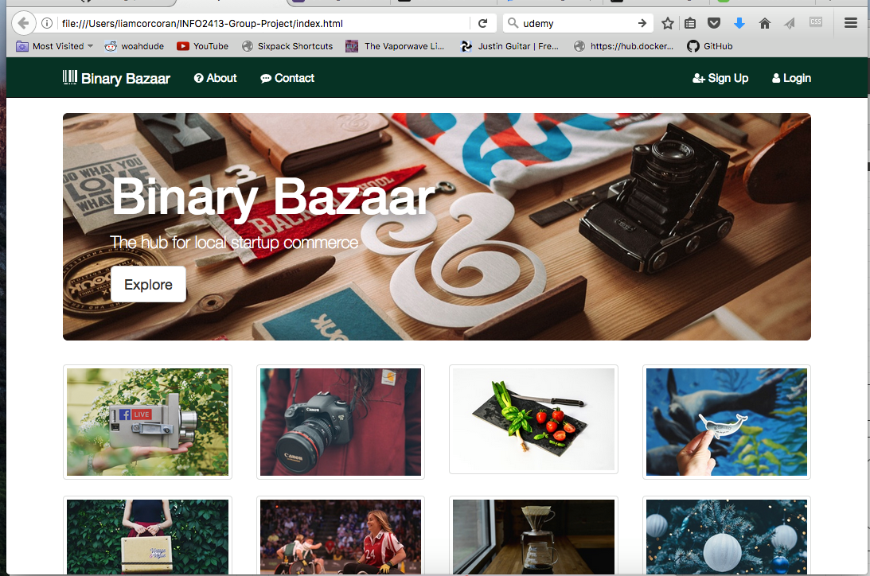
Progress – Index Page
The index page contains a navigation bar using links as of now that will direct the user to the page they have clicked on such as About, Contact, Sign Up, Login.
This page also contains sample images of business identities and products

Slide 12
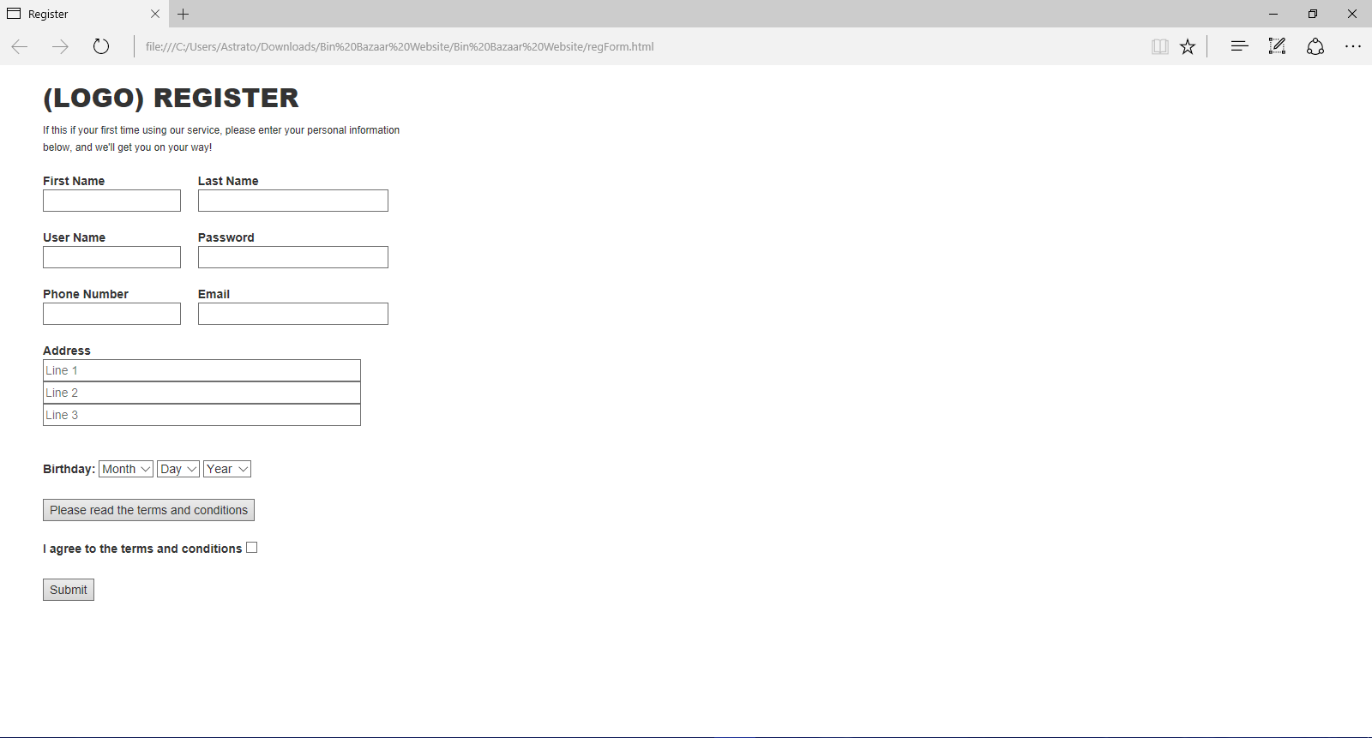
Progress – Sign Up
The sign up page allows to user to create an account by entering a username and password.
The user must agree to the terms and conditions
To create and account the user must enter their information such as name, address, email, phone number, and date of birth.

Slide 13
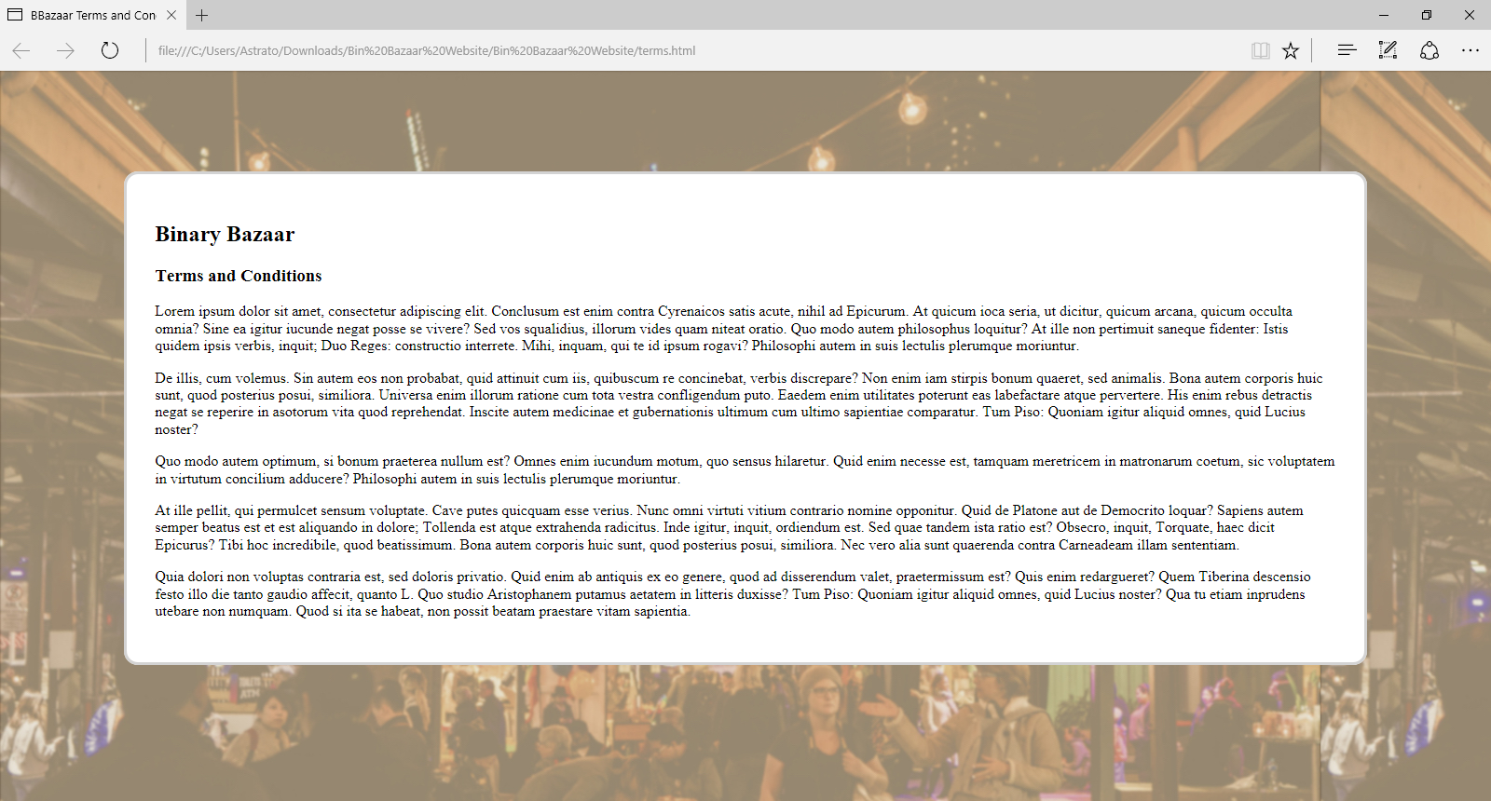
Terms and Conditions Page
The terms and conditions page allows the user to read the rules they have accepted regarding to use this website and creating account.

Slide 14
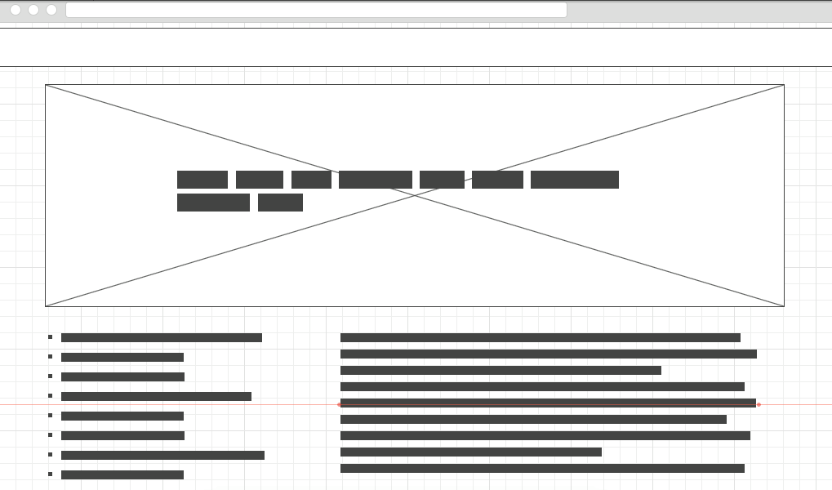
Progress – Store Page
Showcases users items for sale
Navigation of users collection bottom left
Description of collection bottom right

Slide 15
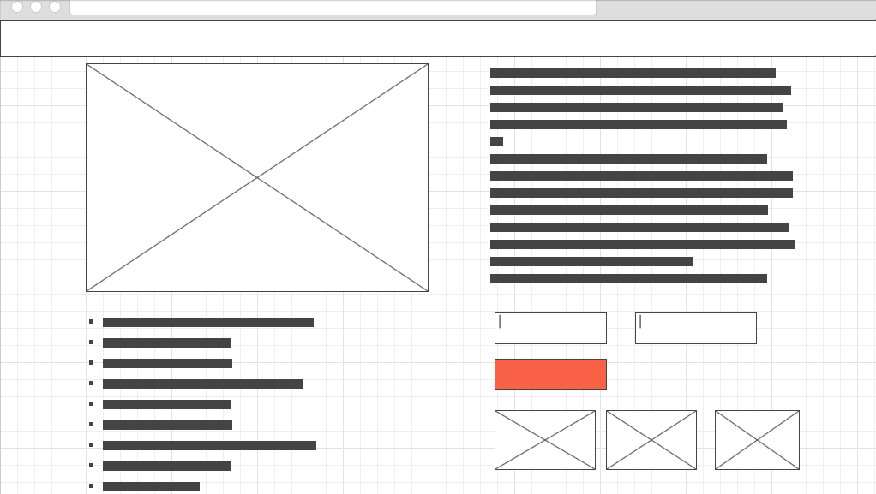
Progress – Item Page
Showcases an item to be purchased
Image right
Description left
Options below
Add to cart button
Recommended items (images 3)
Specs in point form

Slide 16
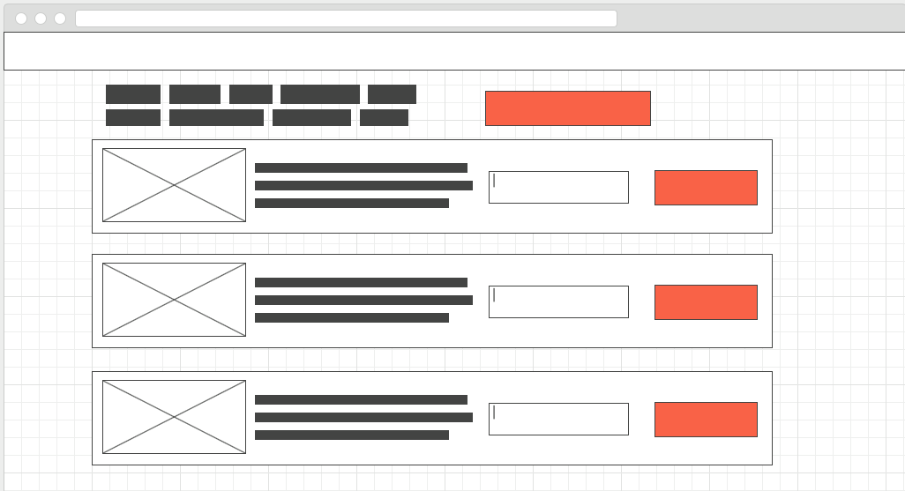
Progress – Cart Page
Total Price
Check out button
Modular list of items in cart
Image of item
Description
Option (amount/size etc)
Remove button

Slide 17
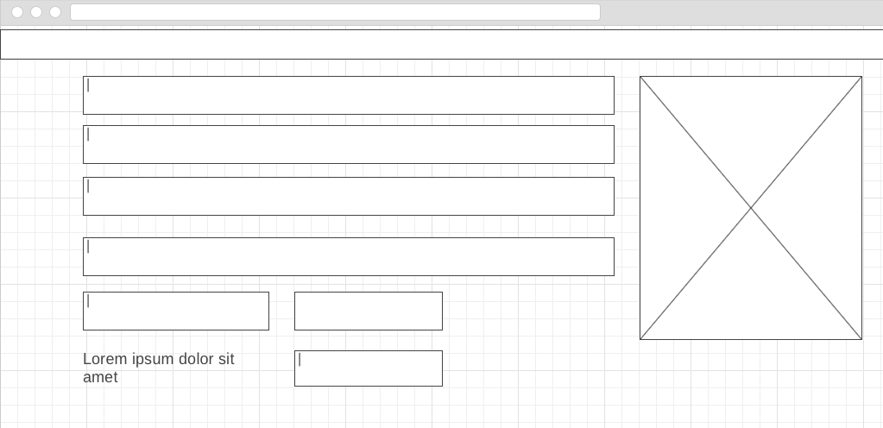
Progress – Check Out Page
Form for payment information
Payment info
verification
Image of one item in cart on right

Slide 18
Issues
At this moment, we have not encountered any issues creating our webpages for our online market website.

Slide 19
Risk Compensation
Personnel
Modular phase strategy allows for task load balancing between group members
Technology
The creation of features is scheduled on an as-needed basis, meaning that the most important work is completed first and refining will occur afterwards
This allows us to find out what works early enough to still have time to change strategy or technology
Scope
Creating features in parallel will allow coaching within the team, which may help with the abilities that fall short within the group

